Slide 1
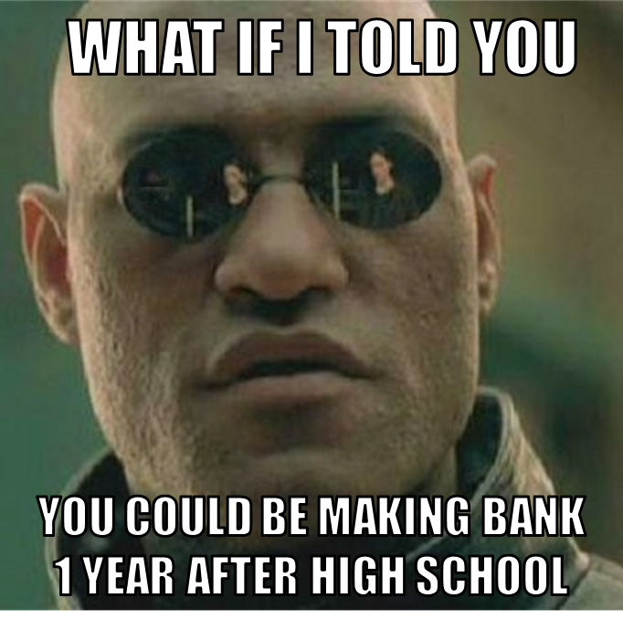

Learn From:
Aviation
Forensics
Building & Design
Marketing & Business
Tinkering & Innovation
Agriculture & Natural Resources
Health & Medical Advancement
Start-Ups
Web Design
Industrial Manufacturing
Technology &Security
Hospitality & Tourism
Digital Arts & Design
Teaching & Learning
International
Baccalaureate Studies
Contact ______ to learn about the Future Ready Institutes
Learn more at ………………………………….com

